Slide 1
Sales analysis
YI (PEARL) WU
22 Jan 2023

Slide 2
Business scenario & questions
Walmart is one of the world's largest retailers with more than 10500 stores over 24 countries. In this presentation, I would like to analyse the store sales data from Walmart to find out the reasons that may impact sales, such as store size, unemployment rate, and holidays.
What is the sales trend overall?
What are the reasons that would impact sales?
Stores
Store size
Store type
Unemployment rate
Promotions
Holiday seasons
Anything else

Slide 3
Audience & Benefits
Audience:
Management from retailers or those who would assign resources in retail companies
Marketing team
Merchandise team
Benefits:
Identify the reasons might impact sales
Track sales metrics
Efficient allocation on resources
Better decision making for merchandise team

Slide 4
About the report
Dataset: Walmart sales dataset
Analysis method: Line Chart, area chart, bar/column chart, donut chart.
Platform: Power BI

Slide 5
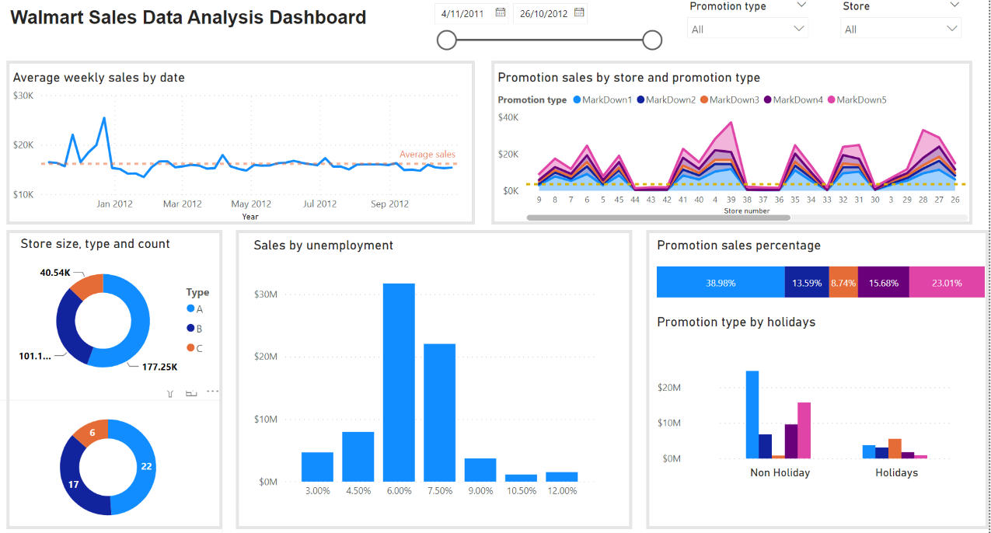
Dashboard preview

Slide 6
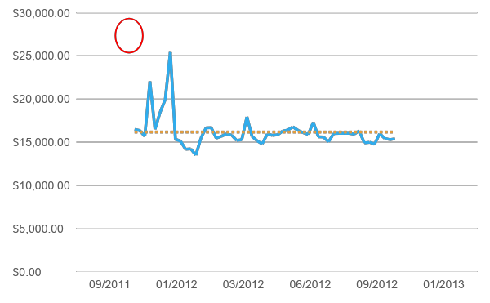
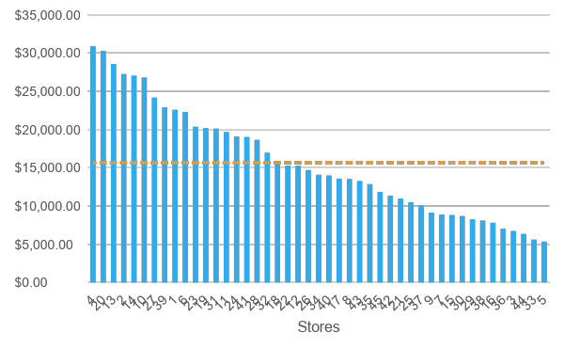
Business insights: overview
Sales by time
Sales by stores

Slide 7
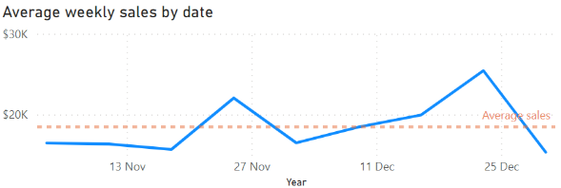
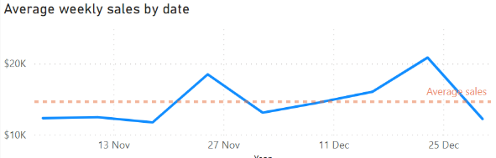
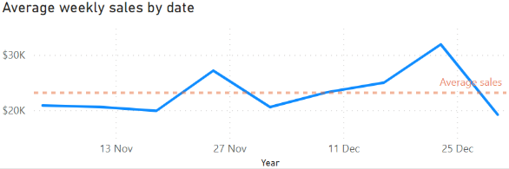
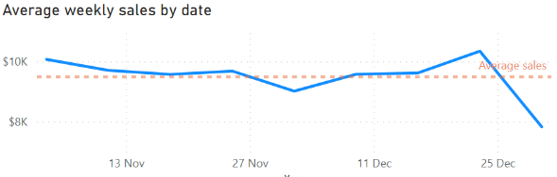
Business insights: stores
All stores view
Type B store view
Type A store view
Type C store view

Slide 8
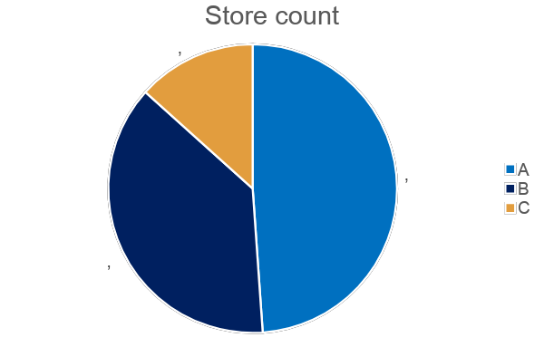
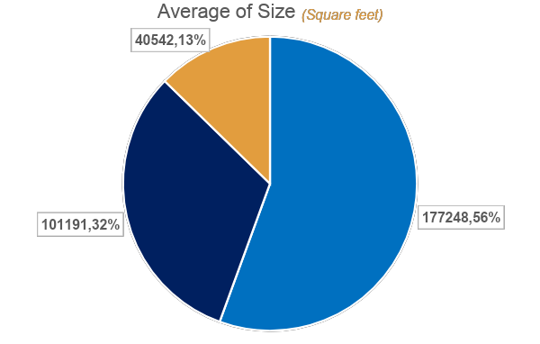
Stores: size and type

Slide 9
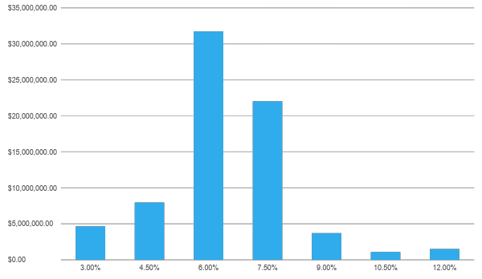
Unemployment

Slide 10
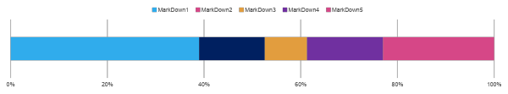
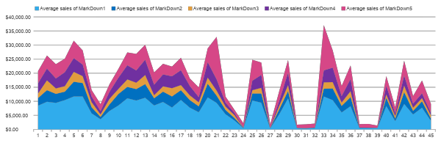
Promotion types

Slide 11
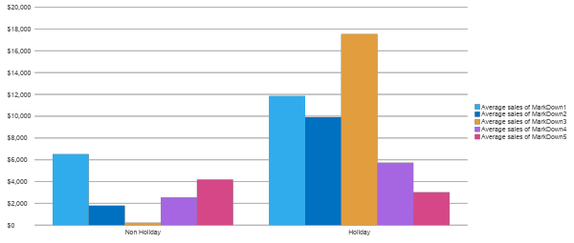
Holiday seasons

Slide 12
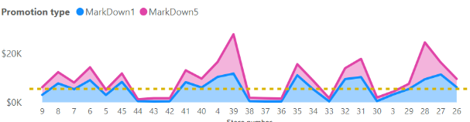
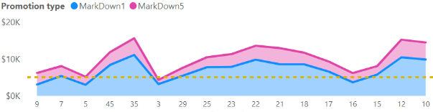
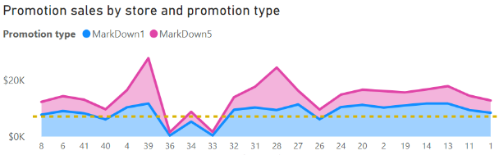
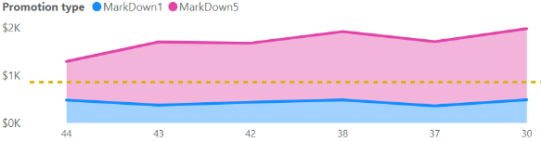
MarkDown 1 vs MarkDown 5
All store types view
store type B view
store type A view
store type C view

Slide 13
Suggestions and conclusion
Bigger stores contribute more revenues.
Unemployment rate won’t have huge impact on sales, it’s a good opportunity to have more promotions when it is around 6%-7%
Promotion 5 is not suitable for holidays
Keeping running Promotion 1 if possible

Slide 14
Thank you

